Slide 1
— RETAIL ANALYTICS · SQL & PYTHON STUDY
CUSTOMER SHOPPING BEHAVIOR ANALYSIS
TRANSACTIONAL STUDY · 3,900 RECORDS

Slide 2
— EXECUTIVE SUMMARY
PROJECT OVERVIEW
This project analyzes customer shopping behavior using transactional data from 3,900 purchases across various product categories. The goal is to uncover insights into spending patterns, customer segments, product preferences, and subscription behavior to guide strategic business decisions.
3,900
18
SQL + PYTHON
CUSTOMER PURCHASES
OBSERVED DIMENSIONS
Full transactional dataset across diverse categories.
Demographics, purchase details, and promotional attributes.
ANALYTICAL STACK
Data cleaning, feature engineering, and relational queries.
02
ANALYTICAL BRIEF · STRATEGIC BUSINESS DECISION FRAMEWORK

Slide 3

— DATASET OVERVIEW
DATASET SUMMARY
Rows: 3,900
Columns: 18
Key features: customer demographics (Age, Gender, Location, Subscription Status); purchase details (Item Purchased, Category, Purchase Amount, Season, Size, Color); shopping behavior (Discount Applied, Promo Code Used, Previous Purchases, Frequency of Purchases, Review Rating, Shipping Type)
Missing data: 37 values in Review Rating column
SUMMARY SPECIFICATIONS · 3,900 PURCHASES · 18 FEATURES

Slide 4
— DATA PREPARATION & PIPELINE
EXPLORATORY DATA ANALYSIS USING PYTHON
Data loading: imported the dataset using pandas
Initial exploration: used df.info() to check structure and .describe() for summary statistics
Missing data handling: imputed missing Review Rating values using the median rating of each product category
Column standardization: renamed columns to snake_case for better readability and documentation
Feature engineering: created age_group by binning customer ages and purchase_frequency_days from purchase data
Data consistency: checked whether discount_applied and promo_code_used were redundant; dropped promo_code_used
Database integration: connected Python script to PostgreSQL and loaded the cleaned DataFrame into the database for SQL analysis
PYTHON WORKFLOW · PANDAS TRANSFORMATION TO POSTGRESQL RELATIONAL SCHEMA
04

Slide 5
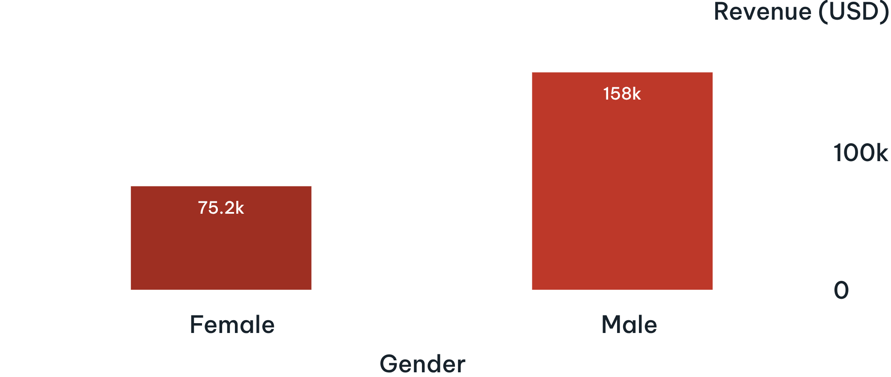
— SQL ANALYSIS 01 · GENDER BREAKDOWN
REVENUE BY GENDER
Compared total revenue generated by male vs. female customers.
$233,081
Male customers generated more total revenue than female customers in this dataset.
Reported revenue was $157,890 for male customers and $75,191 for female customers.
REVENUE TOTALS IN USD · 3,900 TRANSACTION RECORDS
05

Slide 6
— SQL ANALYSIS 02 · PROMOTIONAL BEHAVIOR
HIGH-SPENDING DISCOUNT USERS
Identified customers who used discounts but still spent above the average purchase amount. Total rows: 839.
CUSTOMER ID | PURCHASE AMOUNT (USD) | CUSTOMER ID | PURCHASE AMOUNT (USD)
2 | 64 | 13 | 72
3 | 73 | 16 | 81
4 | 90 | 20 | 90
7 | 85 | 22 | 62
9 | 97 | 24 | 90
12 | 68 | Sample Total | 11 Customers
SAMPLE HIGH-SPENDING DISCOUNT USERS · FILTER: DISCOUNT_APPLIED = TRUE AND PURCHASE_AMOUNT > AVERAGE
06

Slide 7
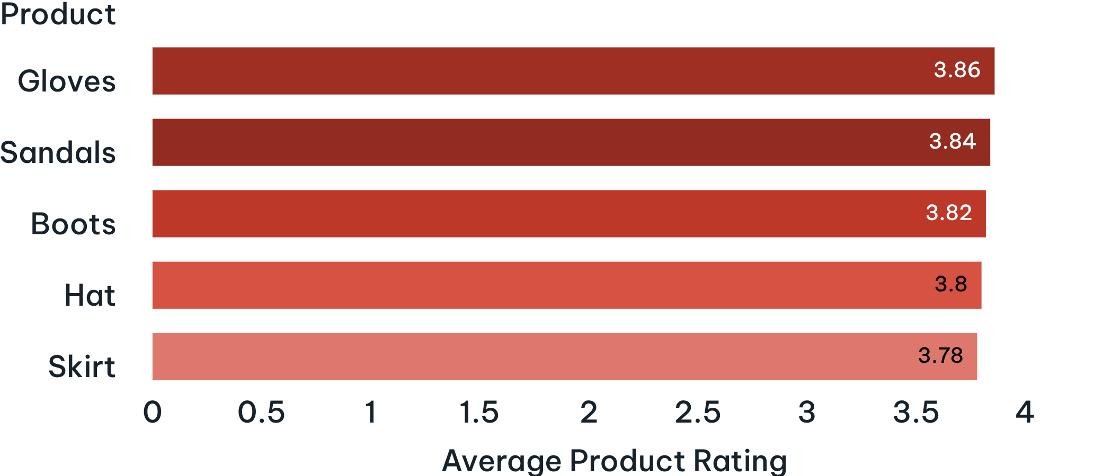
— SQL ANALYSIS 03 · PRODUCT QUALITY
TOP 5 PRODUCTS BY RATING
Products with the highest average review ratings.
3.86
The five highest average product ratings range from 3.78 to 3.86.
Gloves leads with a 3.86 average rating, followed closely by Sandals, Boots, Hat, and Skirt.
AVERAGE PRODUCT RATING OUT OF 5.0 · TOP 5 RANKED ITEMS
07

Slide 8
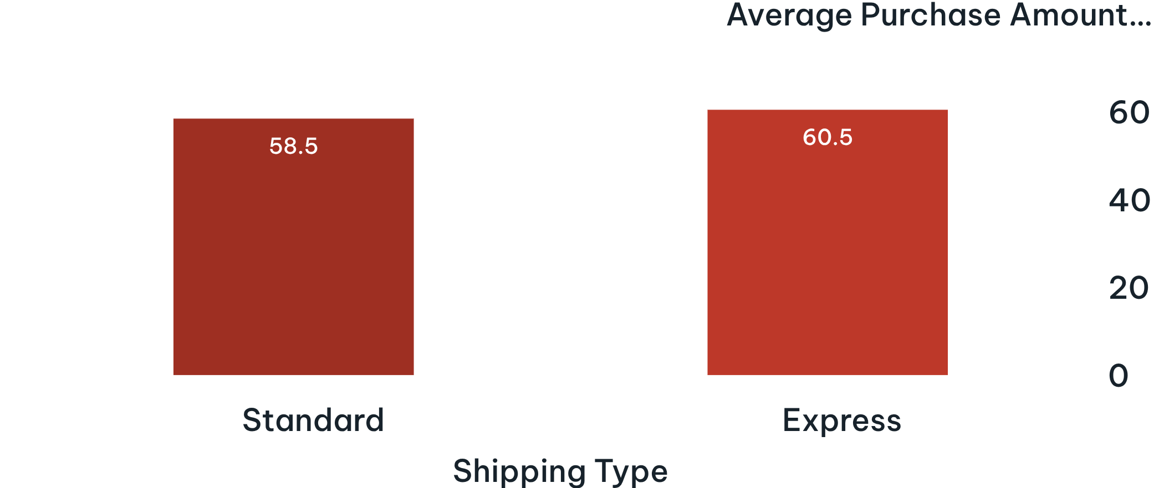
— SQL ANALYSIS 04 · LOGISTICS & FULFILLMENT
SHIPPING TYPE COMPARISON
Compared average purchase amounts between Standard and Express shipping.
$60.48
Average purchase amounts were close for Standard and Express shipping.
Express shipping averaged $60.48 per order compared to $58.46 for Standard shipping.
AVERAGE PURCHASE AMOUNT BY SHIPPING TYPE IN USD
08

Slide 9
— SQL ANALYSIS 05 · SUBSCRIPTION PROGRAM
SUBSCRIBERS VS. NON-SUBSCRIBERS
Compared average spend and total revenue across subscription status.
SUBSCRIPTION STATUS | TOTAL CUSTOMERS | AVERAGE SPEND (USD) | TOTAL REVENUE (USD)
Yes | 1,053 | $59.49 | $62,645
No | 2,847 | $59.87 | $170,436
$59.49
$59.87
SUBSCRIBERS AVERAGE SPEND
NON-SUBSCRIBERS AVERAGE SPEND
Across 1,053 customer records with active subscriptions.
Across 2,847 customer records without subscriptions.
09
SUBSCRIPTION CUSTOMERS, AVERAGE SPEND, AND REVENUE · 3,900 PURCHASES

Slide 10
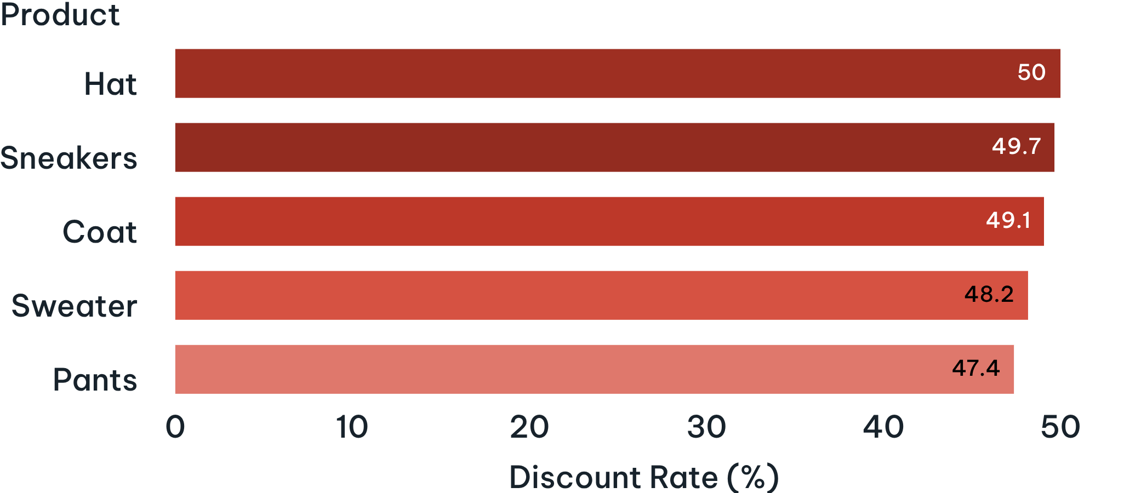
— SQL ANALYSIS 06 · MERCHANDISE PROMOTION
DISCOUNT-DEPENDENT PRODUCTS
Five products with the highest percentage of discounted purchases.
50.0%
The five listed products have discount rates between 47.37% and 50.00%.
Hat leads at 50.00%, followed closely by Sneakers at 49.66%, Coat at 49.07%, Sweater at 48.17%, and Pants at 47.37%.
DISCOUNT RATE BY PRODUCT (%) · TOP 5 DISCOUNT-DEPENDENT ITEMS
10

